Slide 1
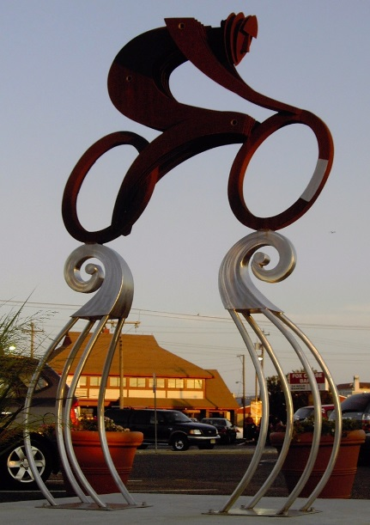
Ocean City’s
9th Annual
Community Bike
Meeting
Presented by BikeOCNJ bikeocnj.org
August 23, 2016

Slide 2
Thank you for coming!
Your input propels OC’s biking initiatives.

Slide 3
Thank You!
Our Mayor, administration, and City Council
Ocean City Chamber of Commerce
Cape May County Freeholders
Ocean City Police Department
We are lucky to have a great team of support!

Slide 4
Benefits of biking
Physical exercise extends your life
Reduces environmental pollutants
Extends the life of our roads
Allows people to transport inexpensively
Brings all ages together
Reduces traffic loads and parking needs
Draws people to a community

Slide 5
Vision
Create an island-wide network of safe, family-friendly bike routes for purpose and pleasure.

Slide 6
Featuring…
OCLP Bridge to Corson’s Inlet Bridge routes
Bay to boardwalk routes
Connectors to downtown, boardwalk, shopping, neighborhoods, schools, community center, etc.
Amenities such as bike racks, rest stations, water, art

Slide 7
Our main routes today
2.5 mile Boardwalk
Bike Blvd. route: Simpson, Haven, West
Multi-Use path on Rt. 52 Bridge
Bay Avenue is building out. (8th-20th Streets)

Slide 8
2008: Haven Ave. Bike Blvd. became our main North/South Artery (9th-35th)

Slide 9
Bike Blvd.
Reduced speed limit to 15mph (20mph)
Added four way stops at cross town streets
Introduced first Sharrow in New Jersey
Created OC1 sign design
Took one year from concept to completion
Created at no design cost to government

Slide 10
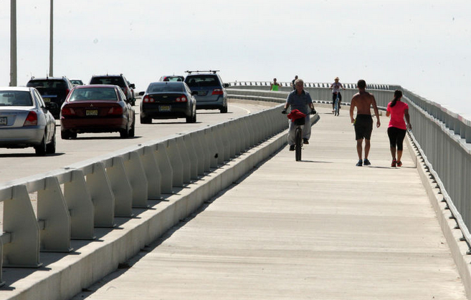
2012: new Rt. 52 Causeway Shared Use Path

Slide 11
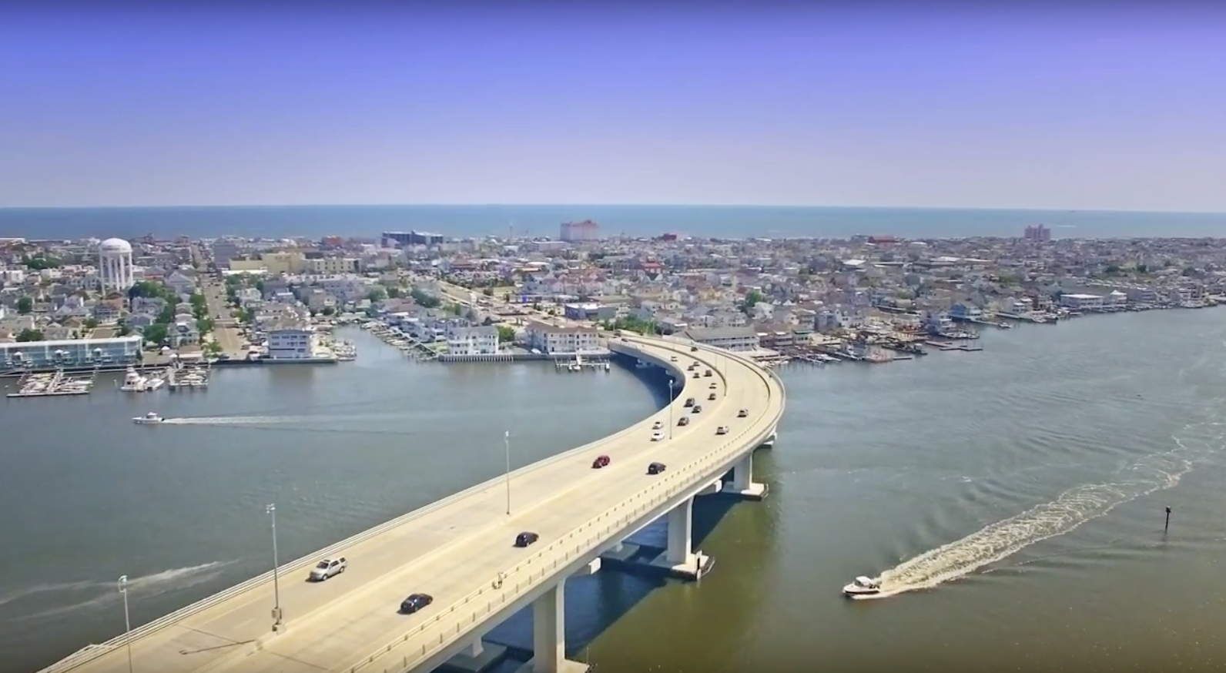

Slide 12
2012: Simpson Ave. extension, Battersea to 1st St.

Slide 13
2012: Boardwalk ordinance changed

Slide 14
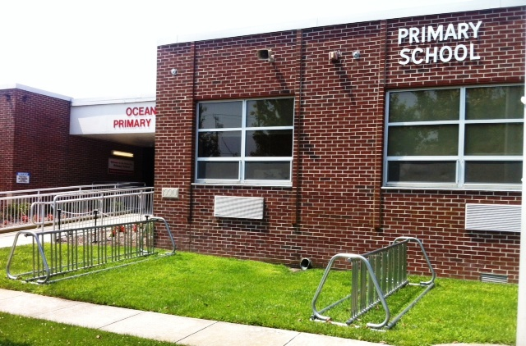
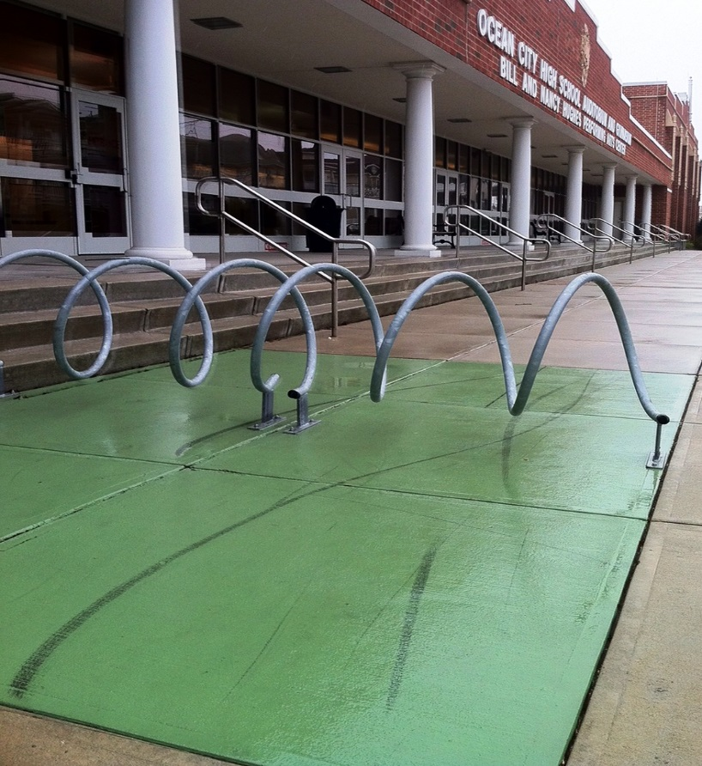
New bike racks at schools

Slide 15
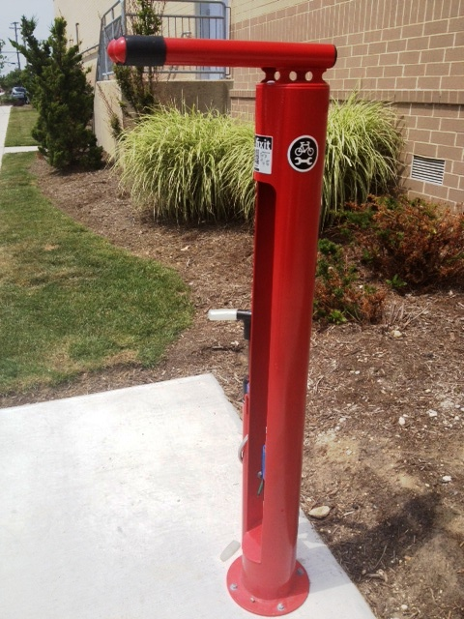
Bicycle Repair Station: 17th and Haven Avenue Thank You Joe Tordella!

Slide 16
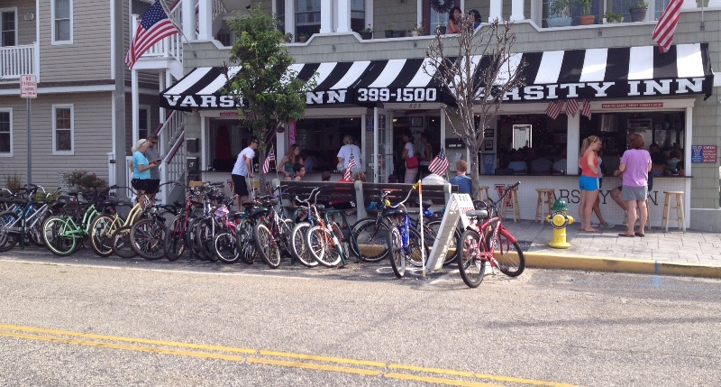
2013: first on-street bike corral

Slide 17
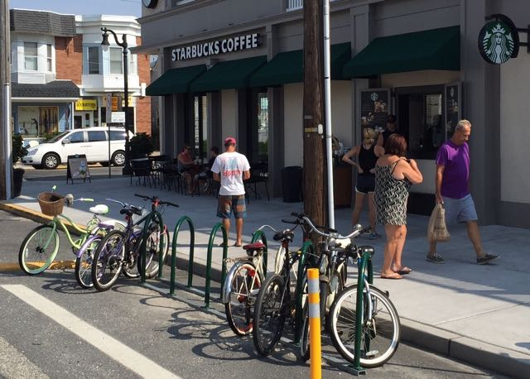
Current on-street bike corrals
Varsity Inn
Ready’s
Sindia Restaurant
Fractured Prune
Starbucks
Island Grill

Slide 18
Bicycle Friendly Community Bronze Award 2012 – 2015 New application just submitted for 2016!

Slide 19
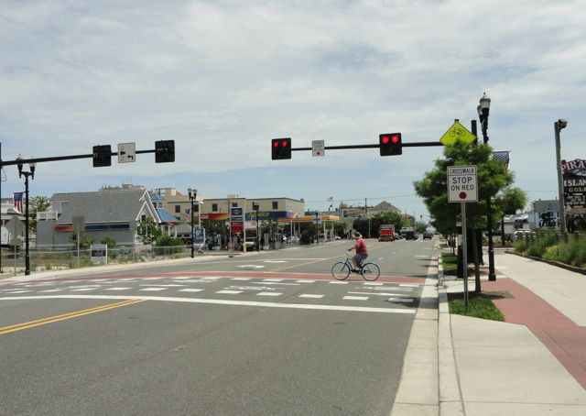
2014: New HAWK signal
at 9th St. & Aldrich Rd.

Slide 20
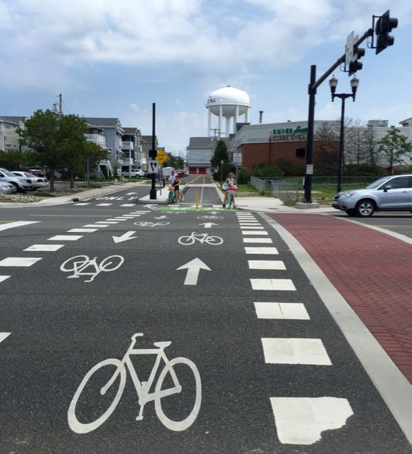
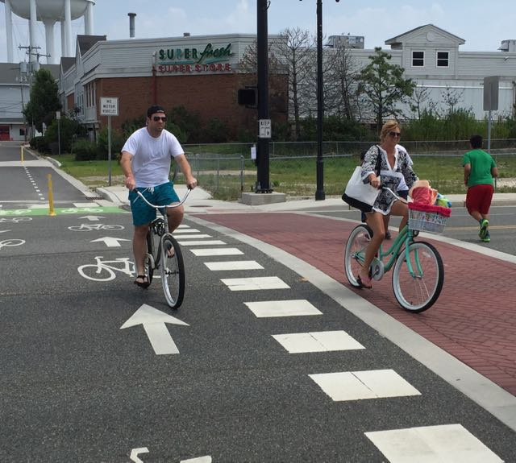
HAWK Signal-
also extends path to 8th St.

Slide 21
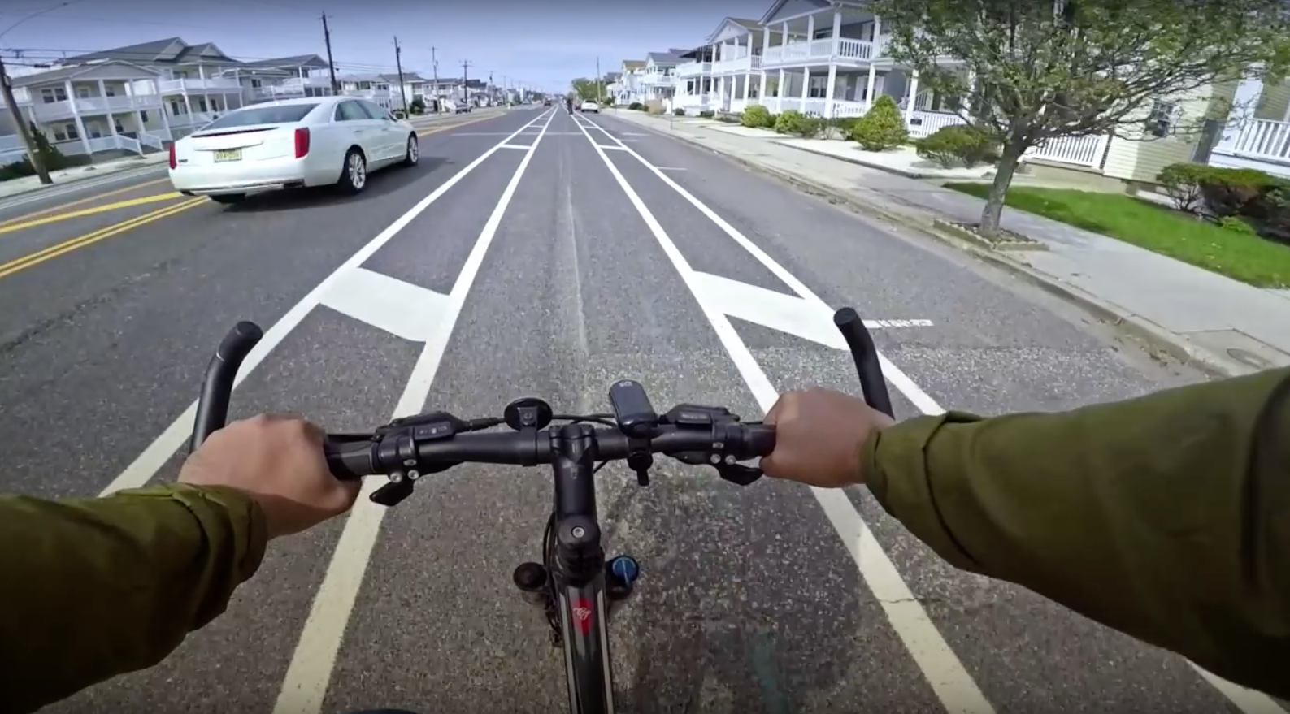
2015 West Avenue from 35th to 55th
^{Thank you to Cape May County!!}

Slide 22
2015: Simpson to W. Inlet via Battersea

Slide 23
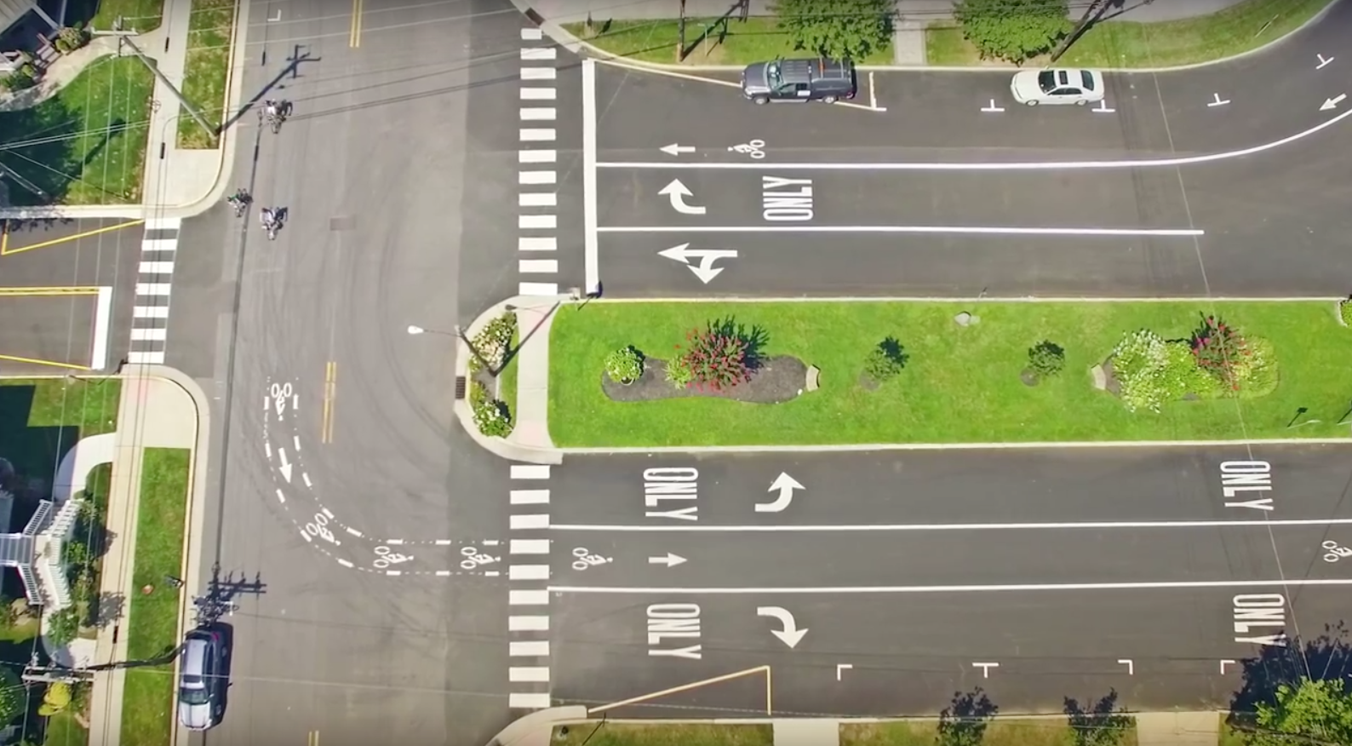
W. Inlet

Slide 24
W. Atlantic Blvd. to Gardens Parkway

Slide 25
2015: Bike Rental Business Safety Signage

Slide 26
2015: Chamber of Commerce Information Center safety poster

Slide 27
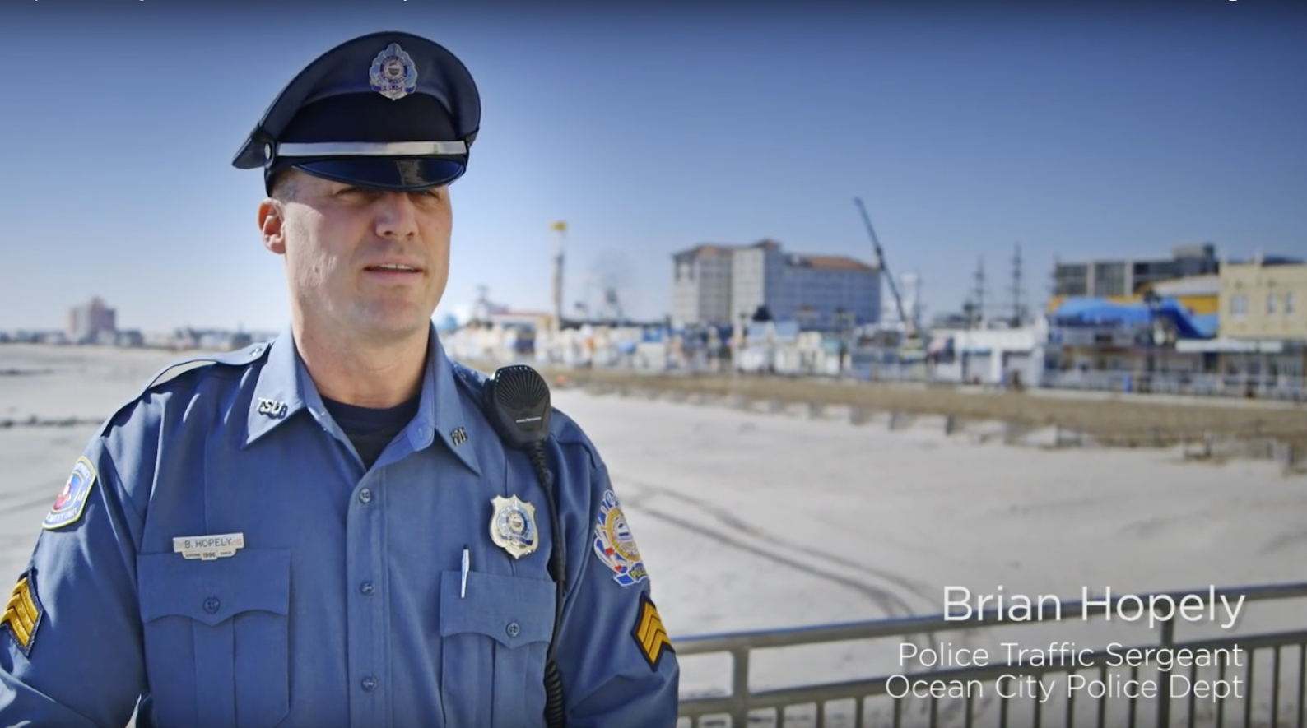
2016: OC recognized in new DOT “road diet” video to show all NJ towns.
For County partnership on West Avenue restriping from 35th to 55th.

Slide 28
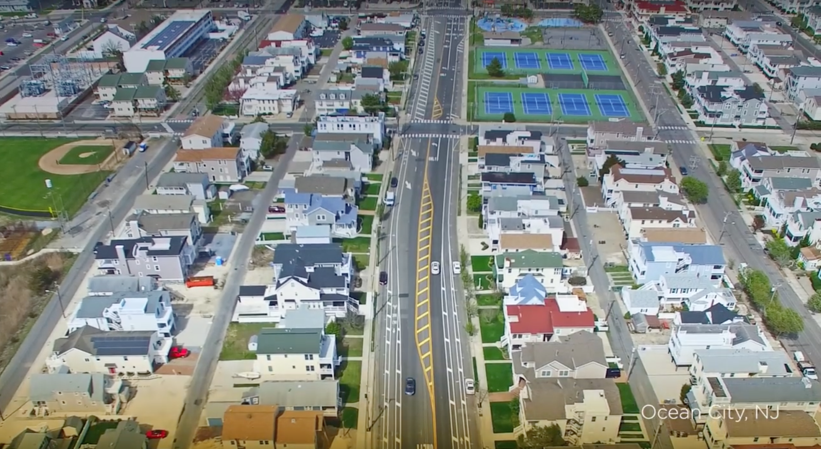

Slide 29
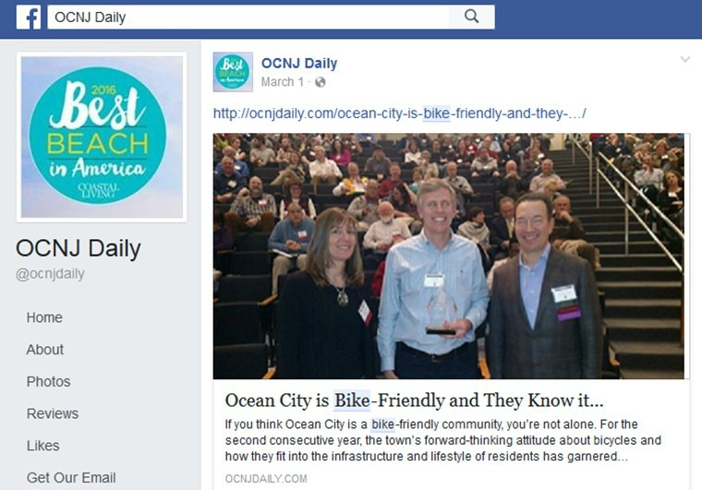
2016: OC recognized at NJ Bike-Walk Complete Street Summit as Best City for “implementation”!

Slide 30
2016:
New bike brochure
Bicycle & Motorist safety tips
Safe biking routes
Points of interest
25,000 printed and distributed
Thank you to OC Public Information office!

Slide 31
2016: Updated Website

Slide 32
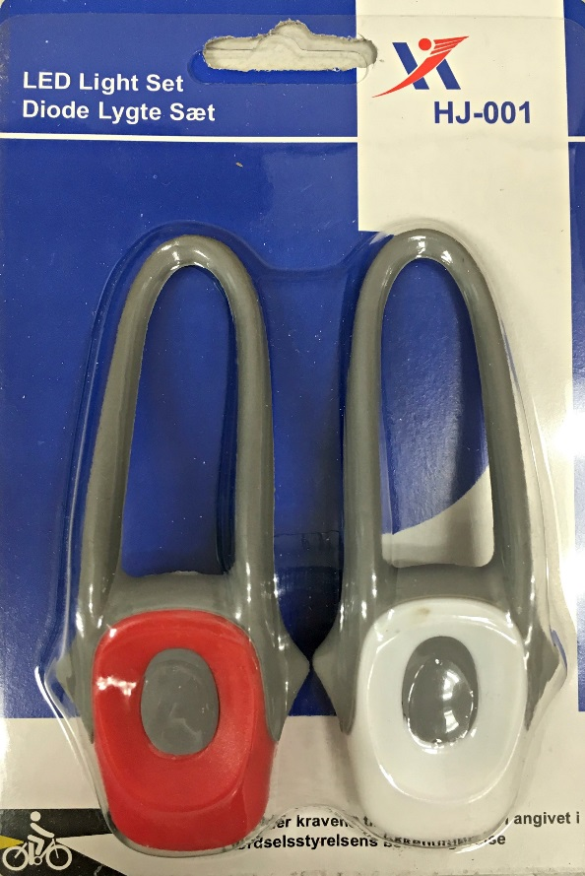
2016: Bike light project
This was a summer 2015 bike meeting recommendation. Thank you!
2000 Bike lights distributed to public and OC public school riders spring/summer 2016

Slide 33
Bike light sponsors

Slide 34
Bikes with lights

Slide 35
Announcement: New bike racks by Summer ’17!!
City received a federal grant that will add:
10 on-street bike corrals in business districts
30 additional beach street end racks

Slide 36
Announcement: New bike lanes by Summer ’17!!
E. Atlantic Blvd. to Beach Rd. to boardwalk
Simpson 1st to 5th , behind Primary School, connecting to Haven Ave. 5th to 8th
Thank you city officials!!

Slide 37
What bike projects should we focus on next?

Slide 38
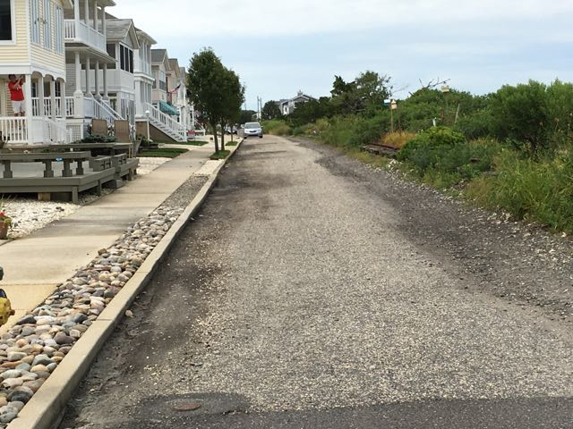
Complete Bike Blvd. from 49th to 55th & Haven?
This is planned for 2017

Slide 39
Safe crossing at 34th & 35th St. & Haven Ave.?

Slide 40
Gateway signage
at main crossroads?

Slide 41
City purchase of 9th Street Green Space?

Slide 42
Better Route Signage?

Slide 43
Safe bike lanes from 9th St. & West Ave. to Boardwalk?

Slide 44
What would you like to see? What needs fixing? How can we be a better bike town?

Slide 45
Please continue to share your ideas with us at…
BikeOCNJ.org
Tom Heist heistiv@gmail.com
Drew Fasy fazeoc@comcast.net

Slide 46
Thank you for coming!
Please ride safely.

