Slide 1
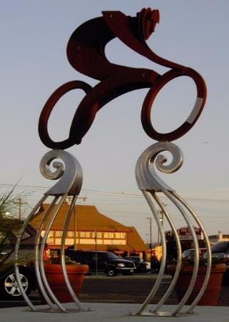
Ocean City’s
11th Annual
Community Bike
Meeting
Presented by BikeOCNJ
bikeocnj.org
August 22, 2018

Slide 2
Thank you for coming!
Your input propels OC’s biking initiatives.

Slide 3
Thank You!
Our Mayor, administration, and City Council
Ocean City Chamber of Commerce
Cape May County Freeholders
Ocean City Police Department
We are lucky to have a great team of support!

Slide 4
Benefits of biking
Physical exercise extends your life
Reduces traffic loads and parking needs
Reduces environmental pollutants
Extends the life of our roads
Allows people to transport inexpensively
Brings all ages together
Draws people to a community

Slide 5
BikeOCNJ Vision
Create an island-wide network of safe, family-friendly bike routes and help educate cyclists, motorists and pedestrians to safely share the road.

Slide 6
Featuring…
OCLP Bridge to Corson’s Inlet Bridge routes
Bay to boardwalk routes
Connectors to downtown, boardwalk, shopping, neighborhoods, schools, community center, etc.
Amenities such as bike racks, rest stations, water, art

Slide 7
Our main routes today
2.5 mile Boardwalk
Bike Blvd. route: Haven /Simpson
West & Bay
Multi-Use path on Rt. 52 Bridge

Slide 8
2008: Haven Ave. Bike Blvd. became our main North/South Artery (9th-35th)

Slide 9
Our Bike Blvd.
Reduced speed limit
Added four way stops at cross town streets
Introduced first Sharrow in New Jersey
Created OC1 Route and sign design
Took one year from concept to completion
Created at no design cost to government

Slide 10
2011: Ocean City received a $90k NJDOT engineered blueprint with recommendations to safely bike from the Corsons Inlet Bridge to the OC-Longport Bridge.

Slide 11
DOT study recommended a specific route with traffic-calming features such as Sharrows, diverters, circles, reduced speed limits, and improved signage.
Many of our improvements have come from this study!

Slide 12
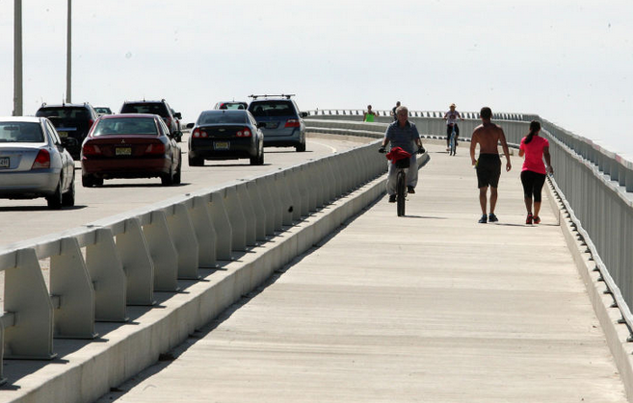
2012: new Rt. 52 Causeway Shared Use Path

Slide 13
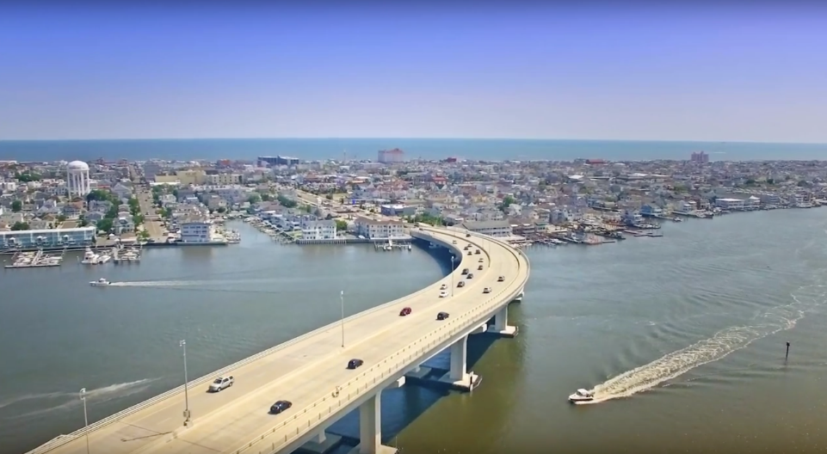

Slide 14
2012: Boardwalk ordinance changed

Slide 15
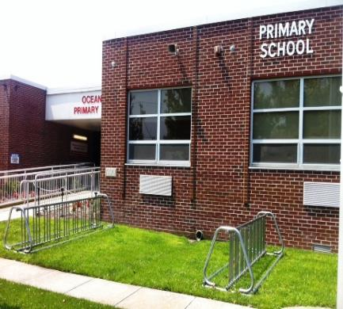
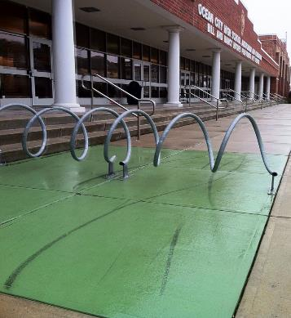
New bike racks at schools

Slide 16
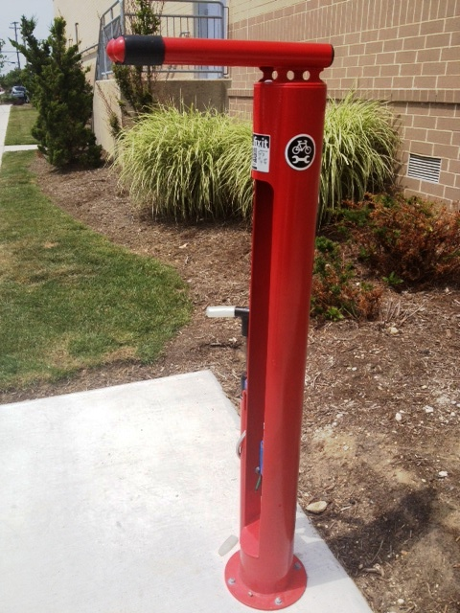
Bicycle Repair Station: 17th and Haven Avenue Thank You Joe Tordella!

Slide 17
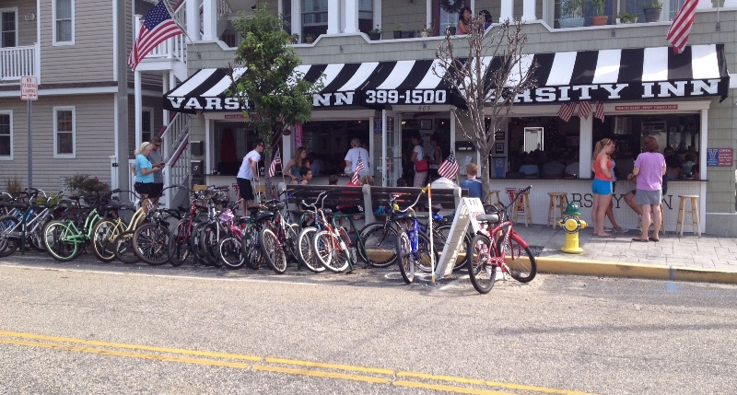
2013: first on-street bike corral

Slide 18
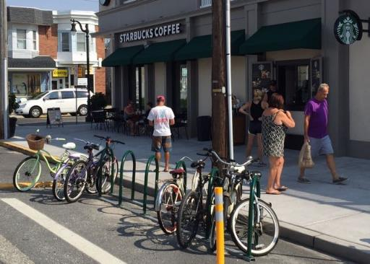
Current on-street bike corrals
Varsity Inn
Ready’s
Sindia Restaurant
Fractured Prune
Starbucks
Island Grill

Slide 19
Bicycle Friendly Community Bronze Award 2012 – 2016

Slide 20
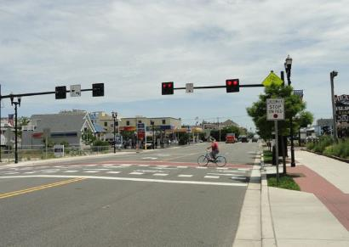
2014: New HAWK signal
at 9th St. & Aldrich Rd.

Slide 21
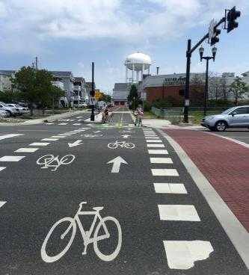
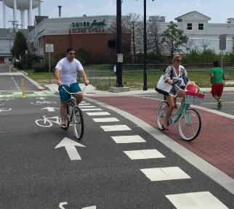
HAWK Signal-
also extends path to 8th St.

Slide 22
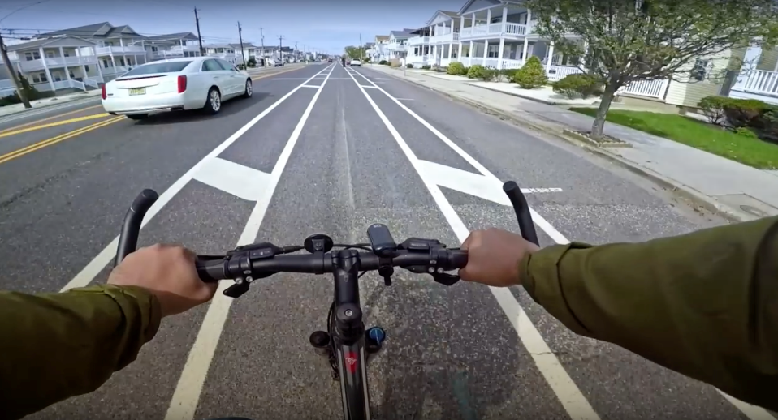
2015 West Avenue from 35th to 55th
^{Thank you to Cape May County!!}

Slide 23
2015: Simpson to W. Inlet via Battersea

Slide 24
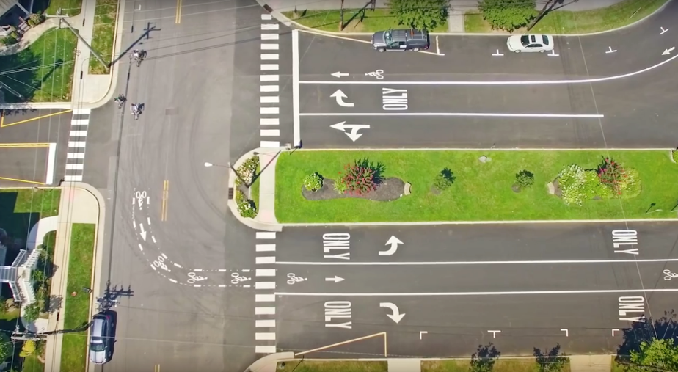
W. Inlet

Slide 25
W. Atlantic Blvd. to Gardens Parkway

Slide 26
2015: Bike Rental Business Safety Signage

Slide 27
2015: Chamber of Commerce Information Center safety poster

Slide 28
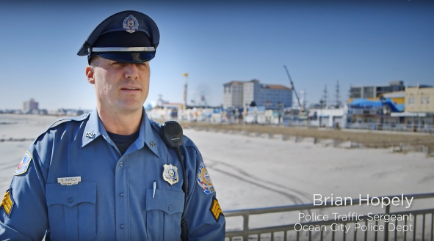
2016: OC recognized in new DOT “road diet” video to show all NJ towns.
For County partnership on West Avenue restriping from 35th to 55th.

Slide 29
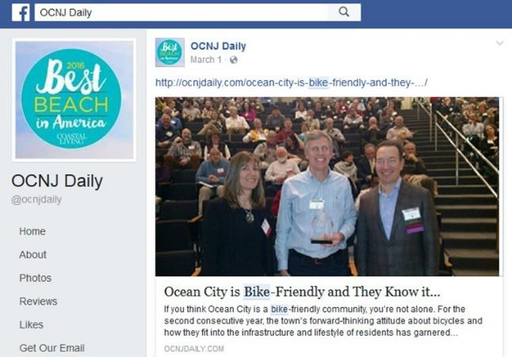
2016: OC recognized at NJ Bike-Walk Complete Street Summit as Best City for “implementation”!

Slide 30
2016:
New bike brochure
Printed each year since
Bicycle & Motorist safety tips
Safe biking routes
Points of interest
Over 25,000 printed and distributed
Thank you to OC Public Information office!

Slide 31
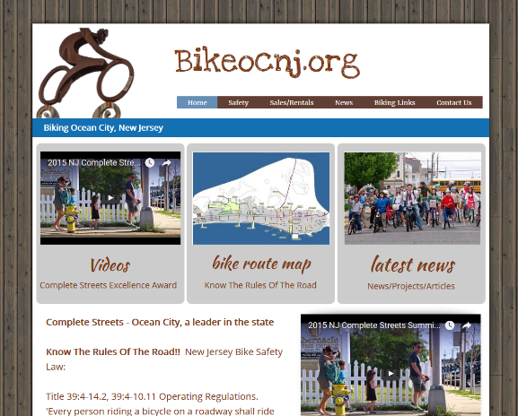
2016: Updated Website

Slide 32
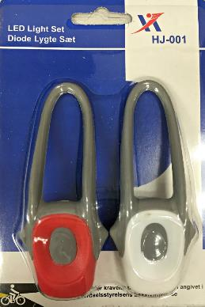
2016: Bike light project
This was a summer 2015 bike meeting recommendation. Thank you!
2000 Bike lights distributed to public and OC public school riders spring/summer 2016

Slide 33
Bike light sponsors

Slide 34
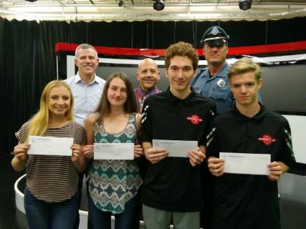
2018 Bike Safety PSA’s
Thanks to OCHS TV/Media Production Department
Teachers Greg Wheeldon and Steve Trauger
OCPD, PBA Local 61, Sgt. Brian Hopely
From left in front, seniors Alexa Johnson and Aili Martin with juniors Jacob Schneider and Zach Card.

Slide 35
Current Project: Simpson Ave. Battersea to 5th St.

Slide 36
Current Project: OC Primary School

Slide 37
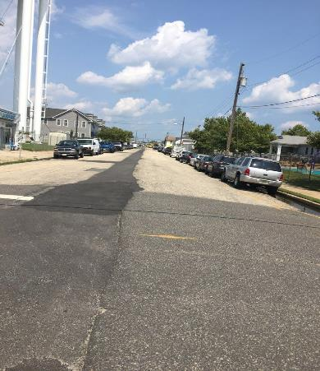
Current Project: Simpson Ave. 6th St. to 8th St

Slide 38
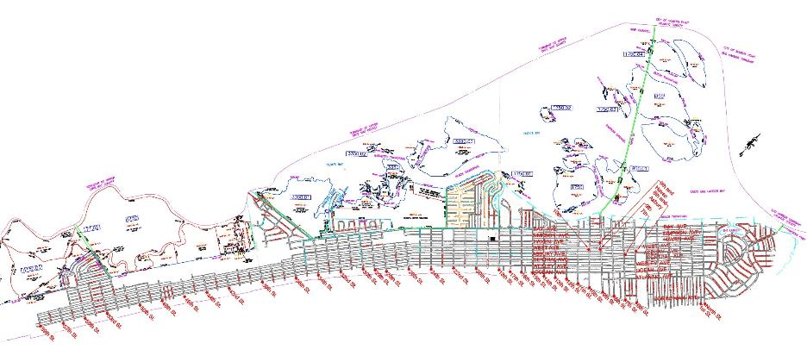
New bike racks Spring 2019!

Slide 39
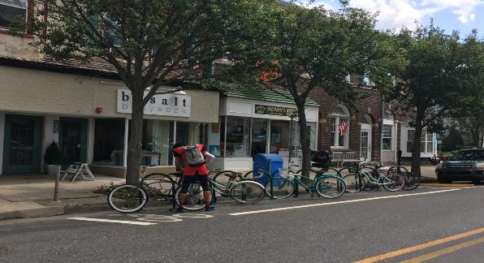
Tentative Project to Include 40 New Bike Rack Locations
10 -15 In-street Bike Corrals
25 – 30 Beach Locations

Slide 40
Focus For Future:
Educate! Educate! Educate!
Improve North-South Bike Boulevard
Build East-West Connectors

Slide 41
Please continue to share your ideas with us at…
BikeOCNJ.org
Tom Heist heistiv@gmail.com
Drew Fasy fazeoc@comcast.net
Jen Bowman ocwind1@gmail.com

Slide 42
Thank you for coming!
Please ride considerately and safely.

